Slide 1

Parallel Social Behavior-Based Algorithm for Influential User Identification - PSAIIM
Presenters: Ahmed Ali Zahid, Shaharyar Rizwan, Moazzam Hafeez

Slide 2



Influence Maximization ( IM )
IM
Identify users who spread information the most.
Applications
Viral marketing, Epidemic control, Political campaigns.
Why PSAIIM?
Traditional IM methods focus on network structure alone.
Social behaviors critical but under explored
.

Slide 3





Motivation for PSAIIM
Semantic Interactions
Real-world user interactions are semantic (interests, actions), not just topological.
Scalability Challenges
Graphs are growing massively — scalability issues.
Combined Approach Needed
Parallelism and semantic modeling needed together.
PSAIIM Solution
PSAIIM bridges behavior modeling + parallel computation.

Slide 4



PSAIIM Algorithm Overview
Two-stage model:
Stage 1: Calculate Influence Power (considering behavior + interests).
Stage 2: Identify influential seed nodes.
Key features:
Semantic modeling (social behavior + interests).
Perfect parallelism using SCC/CAC partitioning.
Novel use of Influence-BFS Tree for seed selection.

Slide 5






Key Terminologies
Social Actions
Retweet, Comment, Tag, weighted differently
Interests
Topics followed, measured by Jaccard similarity
SCC
Dense, strongly connected communities
CAC
Weakly linked acyclic communities
Influence-BFS Tree
Propagation rooted at seed nodes

Slide 6




PSAIIM Model Inputs and Parameters
Inputs
G(V, E, A, I): Users, edges, actions, interests
Parameters
Retweet weight: 0.5
Comment weight: 0.35
Tag weight: 0.15
Damping factor (PageRank): 0.85
Outputs
Optimal Seed Set of influential nodes

Slide 7




Influence Power Calculation: Step-by-Step
Graph Partitioning
Graph is partitioned into SCC/CAC communities.
Graph Leveling
Leveling the graph: Independent components computed simultaneously.
Local Influence Modeling
Local influence modeled by personalized weighted PageRank.
Formula Application
IP(u) = d × Σ(ψ(v,u) × IP(v)/OutDegree(v)) + (1-d)/N
ψ(v,u): Combined influence strength based on actions and interest similarity.

Slide 8





User Behavior Weighting in PSAIIM
Not all social actions have equal impact:
Sharing > Commenting > Liking.
Weighting Calculation
Behavior frequency × semantic similarity determines edge weight.
Semantic Correction
Semantic correction ensures real-world social strength modeling.
Friendship Factor
Friendship factor (α-values) adjust behavioral impact in equations.

Slide 9

Influence Node Selection via BFS Trees
Build Influence-BFS Trees
Rooted at candidate seed nodes
Influence Propagation
Through shortest paths in graph
Candidate Evaluation
Size of Influence Tree
Propagation Speed (average rank)
Redundancy Pruning
Detects and prunes overlapping Black Paths

Slide 10





Parallelization Strategy in PSAIIM
Community Detection
Partitions graph into independent SCC and CAC units
OpenMP Parallel Execution
Executes PageRank concurrently within partitions
Synchronization
Level-wise sync respects DAG dependencies
Parallel Primitives
Sort
Scan
Reduction

Slide 11


Algorithm Comparison and Benchmarking
Methods Compared
PSAIIM Advantages
SAIM (Sequential)
Parallel GPU methods
MLIM
Linear Programming (LP)
Coreness, FBI
Faster runtimes
Higher influence spread
Lower memory use

Slide 12
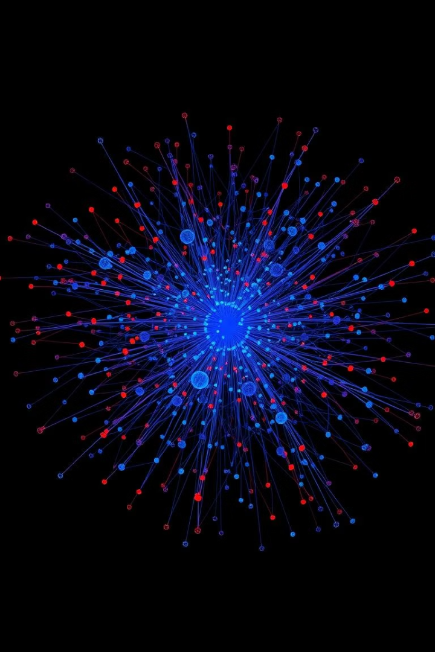
Datasets and Scale of Experiments
Dataset
Nodes
Edges
Tencent Weibo
1M
33M
Higgs Twitter
456K
14M
Twitter (Ego)
81K
1.7M
p2p-Gnutella4
10K
40K

Slide 13
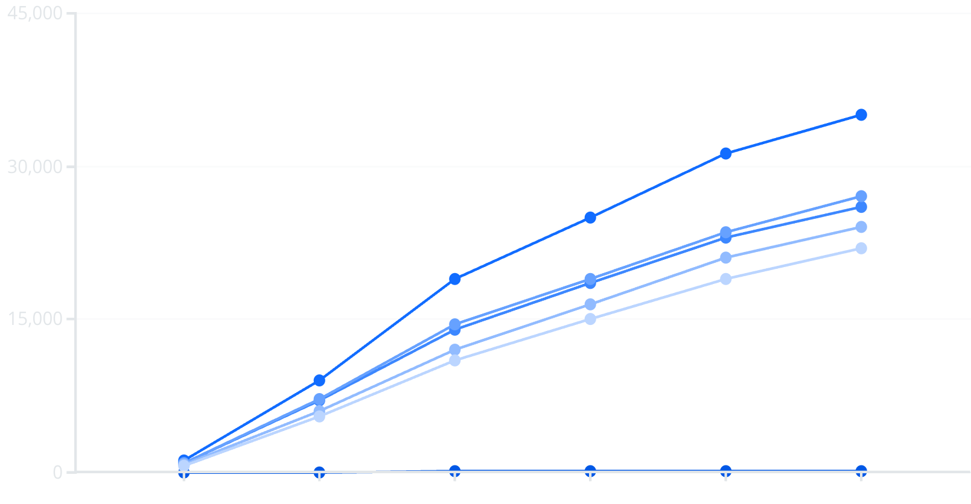
Influence Spread Graph
Seed Nodes
PSAIIM
Parallel
MLIM
LP
FBI
The line chart shows the influence spread (number of influenced users) as the number of seed nodes increases from 5 to 50. PSAIIM consistently outperforms all other algorithms, with significantly higher influence spread across all seed node quantities.

Slide 14
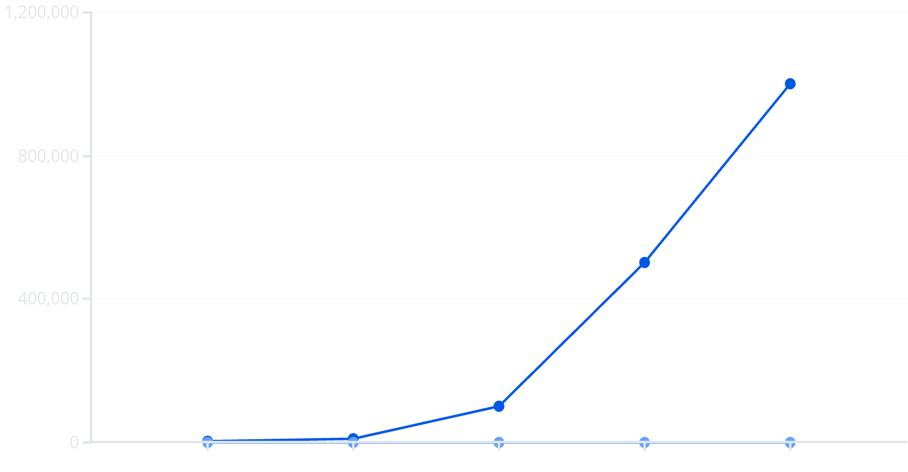
Speedup Graph
Nodes
Speedup
This line chart demonstrates how the speedup factor increases as the number of nodes grows. With 1,000 nodes, the speedup is minimal at 1.18x, but as the dataset size increases to 1,000,000 nodes, the speedup reaches an impressive 15.24x, highlighting PSAIIM's excellent scalability for large networks.

Slide 15
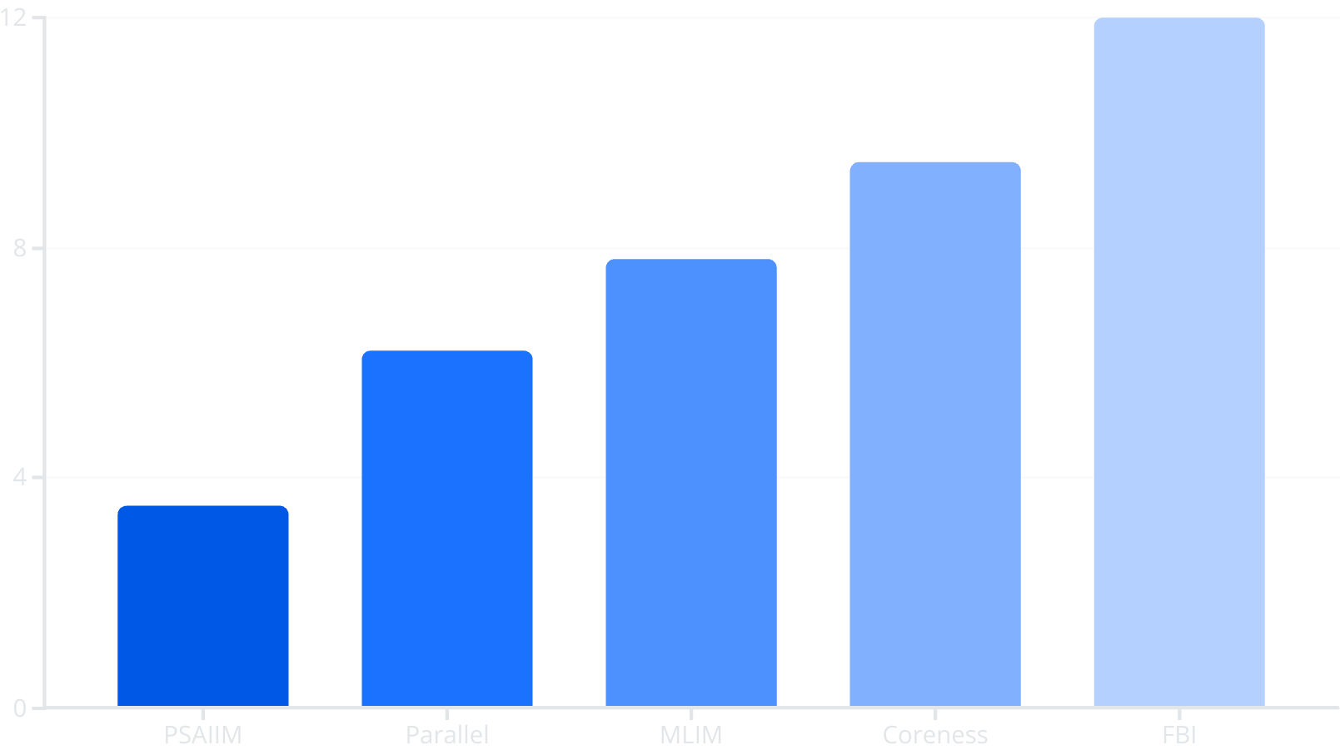
Runtime Comparison
This bar chart compares the runtime in minutes for different algorithms on a dataset of 10,000 nodes. PSAIIM demonstrates the fastest execution time at just 3.5 minutes, which is significantly faster than all competing algorithms. FBI has the longest runtime at 12 minutes, making PSAIIM more than 3 times faster.

Slide 16
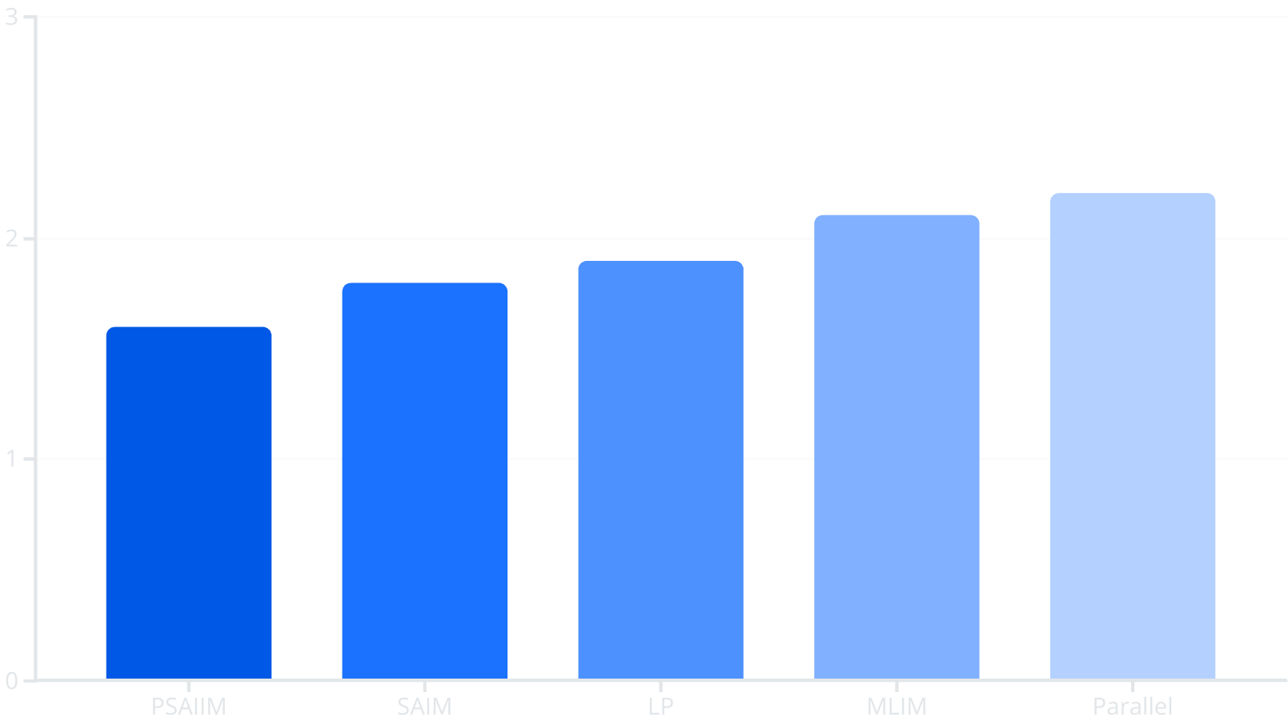
Memory Usage Comparison
The memory usage comparison for the Tencent Weibo dataset shows that PSAIIM is the most memory-efficient algorithm, requiring only 1.6GB. This represents a significant improvement over Parallel and MLIM algorithms which require 2.2GB and 2.1GB respectively.

Slide 17



Strengths, Limitations, and Future Directions
Strengths
User behavior integration
Perfect graph partitioning
OpenMP parallel speedup
Accurate weighted influence modeling
Weaknesses
Depends on semantic data quality
Random semantics reduce accuracy
Limited dynamic network handling
Future Work
Dynamic network adaption
Group Influence Maximization
Distributed GPU scaling

Slide 18

Conclusion
Key Findings
PSAIIM combines semantics + parallelism uniquely.
Outperforms classical and recent models in real-world and synthetic datasets.
Provides a scalable, fast, accurate solution to influence maximization.

Slide 19
Thanks. Questions?

